Slide 1

Cat & Mouse
By Cem Alemdar and Jonathan Shiery
Notes:
0:30, Both

Slide 2
Predator - Prey Simulation
Logline
Notes:
1:00, Cem

Slide 3
Toy’s essential features
Primitive AI
Simulation
Simple as a mouse click
Entertaining to watch
No end condition
Notes:
1:45, Jonathan

Slide 4
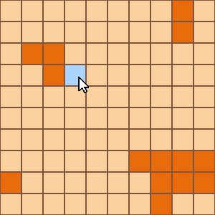
Screen Mockups
Orange = Mouse
Blue = Cat
Notes:
2:45, Jonathan

Slide 5
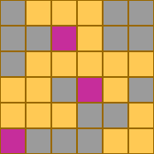
Screen Mockups
Gray = Mouse
Purple = Cat
Notes:
3:45, Cem

Slide 6
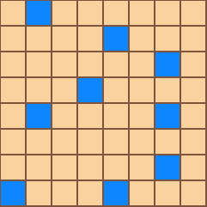
Screen Mockups
Orange = Mouse
Blue = Cat
Notes:
4:15, Jonathan

Slide 7
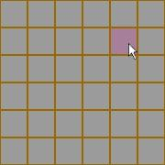
Screen Mockups
Gray = Mouse
Purple = Cat
Notes:
4:45, Cem

Slide 8
The End

